Slide 1

Back to School Night
2022-2023
SECOND GRADE
TRACK A
Notes:
1

Slide 2

About Me
Mrs. Kortum
  Professional Experience:
    Bachelor of Arts, University of California, Santa Barbara
    Teaching Credential, Cal State Fullerton
    Married with 2 children and a Great Dane
    9th Year Teaching
Notes:
2

Slide 3

Goals for the Year
Have every student reach or exceed Common Core State and District standards.
Provide a safe, fun-filled, nurturing learning environment where children thrive.
Increase each child’s academic success in all subject areas.
Develop students’ organizational skills and sense of responsibility.

Slide 4
Expectations
Get a good night's rest and eat a healthy breakfast.
Students come to school by 7:50 and are with the teacher at 8:00 PREPARED TO LEARN.
Make illness the only excuse for absences.
Complete classwork and homework assignments on time.
Read 20 minutes every day in addition to regularly assigned homework.
Memorize math facts to automaticity (study nightly).

Slide 5
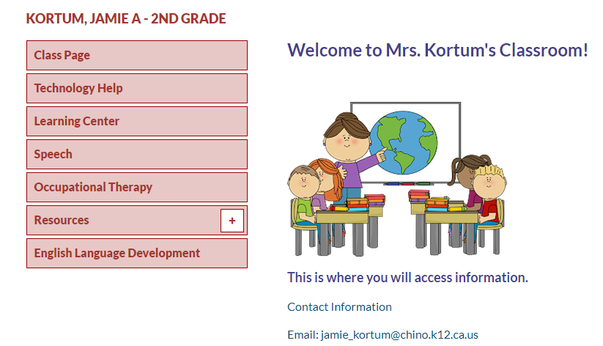
Class Website
Access my website via Cal Aero Website under the classrooms tab.

Slide 6

Classwork
It is important that each student completes his/her classwork. If classwork is not finished in the time allotted, the student may have to complete it at the during recess or at home. Make sure to check your child’s unfinished work section of his/her Aviator folder for any unfinished work nightly. To ensure that students always do their best, they may be asked to do an assignment over.
Notes:
6

Slide 7

McGraw-Hill Reading Wonders
ELA Curriculum
Focus will be on:
  Vocabulary Instruction
  Reading Comprehension Skill Development
  Phonics
  Spelling
  Grammar
  Writing
Writing Domains:
  Informational
  Narrative
  Opinion
Online Access:
Online access for students and parents can be found on your child’s ClassLink account.

Slide 8

Math Curriculum
Savvas Envision Math
Focus will be on:
Operation and Algebraic Thinking
Numbers and Operations in Base Ten
Measurement and Data
Geometry
Online Access:
Online access for students and parents can be found on your child’s ClassLink account.
Supplemental programs utilized daily on Chrome books in class.
Prodigy
Extra Math

Slide 9

Other Core Subjects
English Language Development (ELD)​
- Remediation, Intervention & Enrichment​
- Social Studies- Houghton Mifflin-NGSS​
- Science- Twig- NGSS(\(99999999
- P.E. – Appropriate shoes M,
- Music- Once a week​
-Library

Slide 10

Grading Policy
All grades are a combination of class work, tests, quizzes, class participation, homework, and/or teacher observation.
Notes:
10

Slide 11

Grading Scale
Grade/Number | Meaning
4- Excelling | Student is at the Excelling level of performance. They have an in-depth understanding of grade level performance standards expected at this point in the school year.
3- Achieving | Student is at the Achieving level of performance. They are consistently meeting the grade level performance standards expected at this point in the year.
2- Progressing | Student is at the Progressing level of performance. They are partially meeting the grade level performance standards expected at this point in the year.
1- Beginning | Student is at the Beginning/Standard Not Met level and is not yet meeting grade level performance standards expected at this point in the year.
Standards Based Grading Report Card, resulting in students receiving the grades of 1, 2, 3, and 4.

Slide 12

Homework*
District guidelines are 20-30 focused minutes daily as well as an additional 20 minutes a day of outside reading.
Homework will be assigned Monday through Thursday.
1. Read: 20 minutes. Reading Log due each Friday.
2. Math: Math Homework Book Worksheet due next day
3. Unfinished classwork.
4.Test prep when necessary.
Notes:
12

Slide 13

Absences
Please make sure your child is in school unless ill.
ATTENDANCE COUNTS!
Please try to schedule appointments after school. If you are taking your child out of school, please let me know ASAP. Work missed will need to be completed.
Missed tests will be given the next day the student returns or when time permits.
TARDIES do count against perfect attendance!
Notes:
13

Slide 14
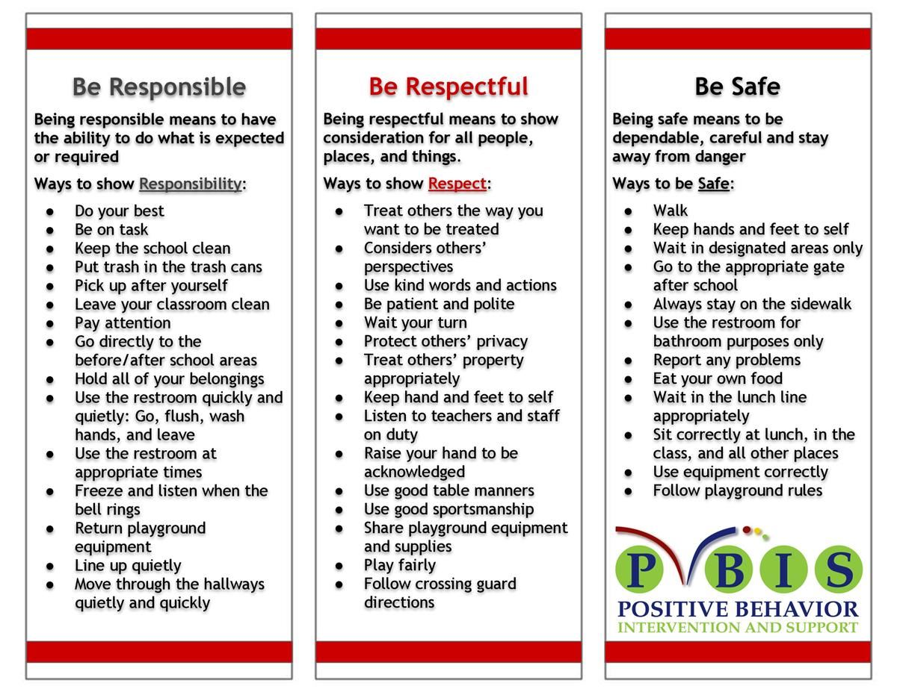
School Wide Behavior Expectations
Rick Morris Behavior Clionstrates exemplary behavior hone call home, email, or notification on daily behavior calendar.

Slide 15

Incident Logs
Incident Logs are used for OUTSIDE minor playground offenses.
  Examples: running before, during, or after school, pushing, playing after bell, using bathroom after the bell …
  Parent signature REQUIRED
  Students return signed slips the following day, or they will miss recess until forms are returned.
Grades 1-6
  Incident Logs will warrant the following consequences (per trimester):
    1st: Warning
    2nd: Loss of a recess and citizenship grade on the report card lowered one level
    3rd: Office referral for 1 lunch detention
    4th: Parent/Student/Teacher Conference with an Administrator

Slide 16
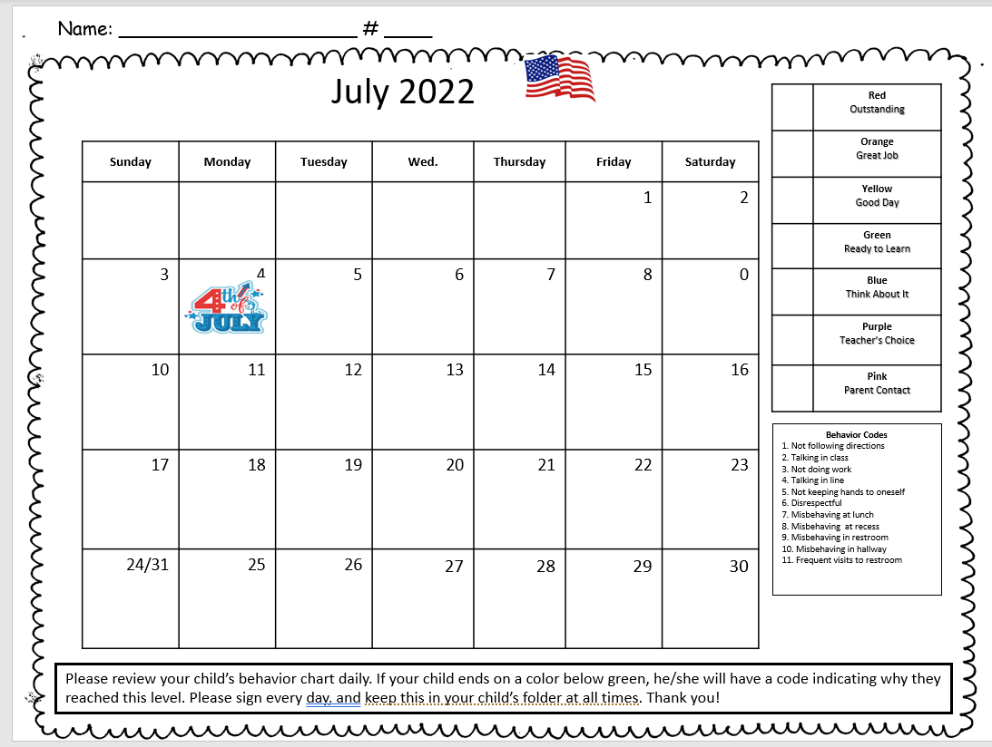

Slide 17

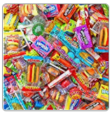
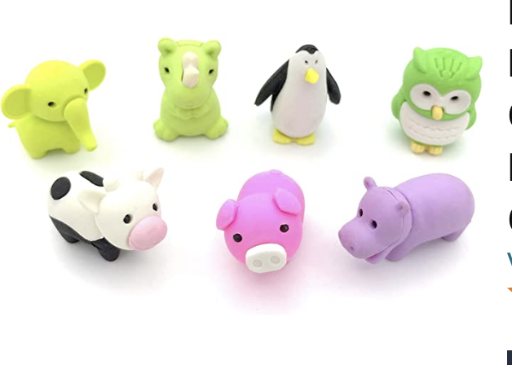
Behavior Expectation Rewards
Student’s will earn AIM High points for positive behavior both in the classroom and on the playground.
Students will be able to redeem points to purchase prizes!

Slide 18


Student Recognition
There will be 3 award assemblies this year- 1each trimester.
Top Flight
Captain
Lieutenant
Perfect attendance (no absences, and no more than 2 tardies or leaving school early)

Slide 19



We’re College Bound!
Graduating Class of 2037!
University of Hawaii
Wear College Bound shirt every Monday and
Aviator shirt on Fridays!
Notes:
19

Slide 20


Birthdays
Birthdays’ will be celebrated in class with a birthday song and dance. Students also get to visit to my prize box.
    Cupcakes, cake, candy, gift bags, and other items are not allowed.
  Birthday invitations can only be given out before/after school off campus. No invitations will be passed out in the classroom.

Slide 21



School Supplies
Please replenish necessary school supplies throughout the year as needed.
      Pencils, Paper, Crayons, Glue Sticks, etc.
      Please pack a lip balm in your child’s backpack.
Notes:
21

Slide 22

Classroom Donations
***White copy paper (8 ½ x 11)
Colored Copy Paper
Tissue Paper
Pencils
Kleenex
Amazon Gift Cards
Amazon Wish List

Slide 23

Parent-Teacher Conferences are coming up.
8/15 - 8/17
These are minimum days!
Please sign up for a date/time on Sign-Up Genius on our classroom page when you receive the notification.
Notes:
23

Slide 24
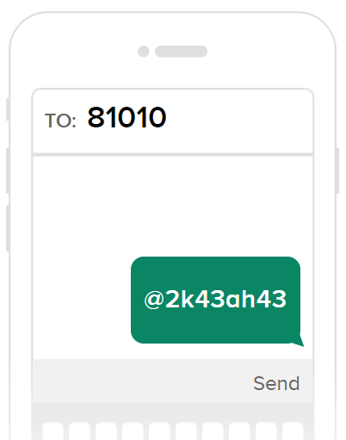


Slide 25

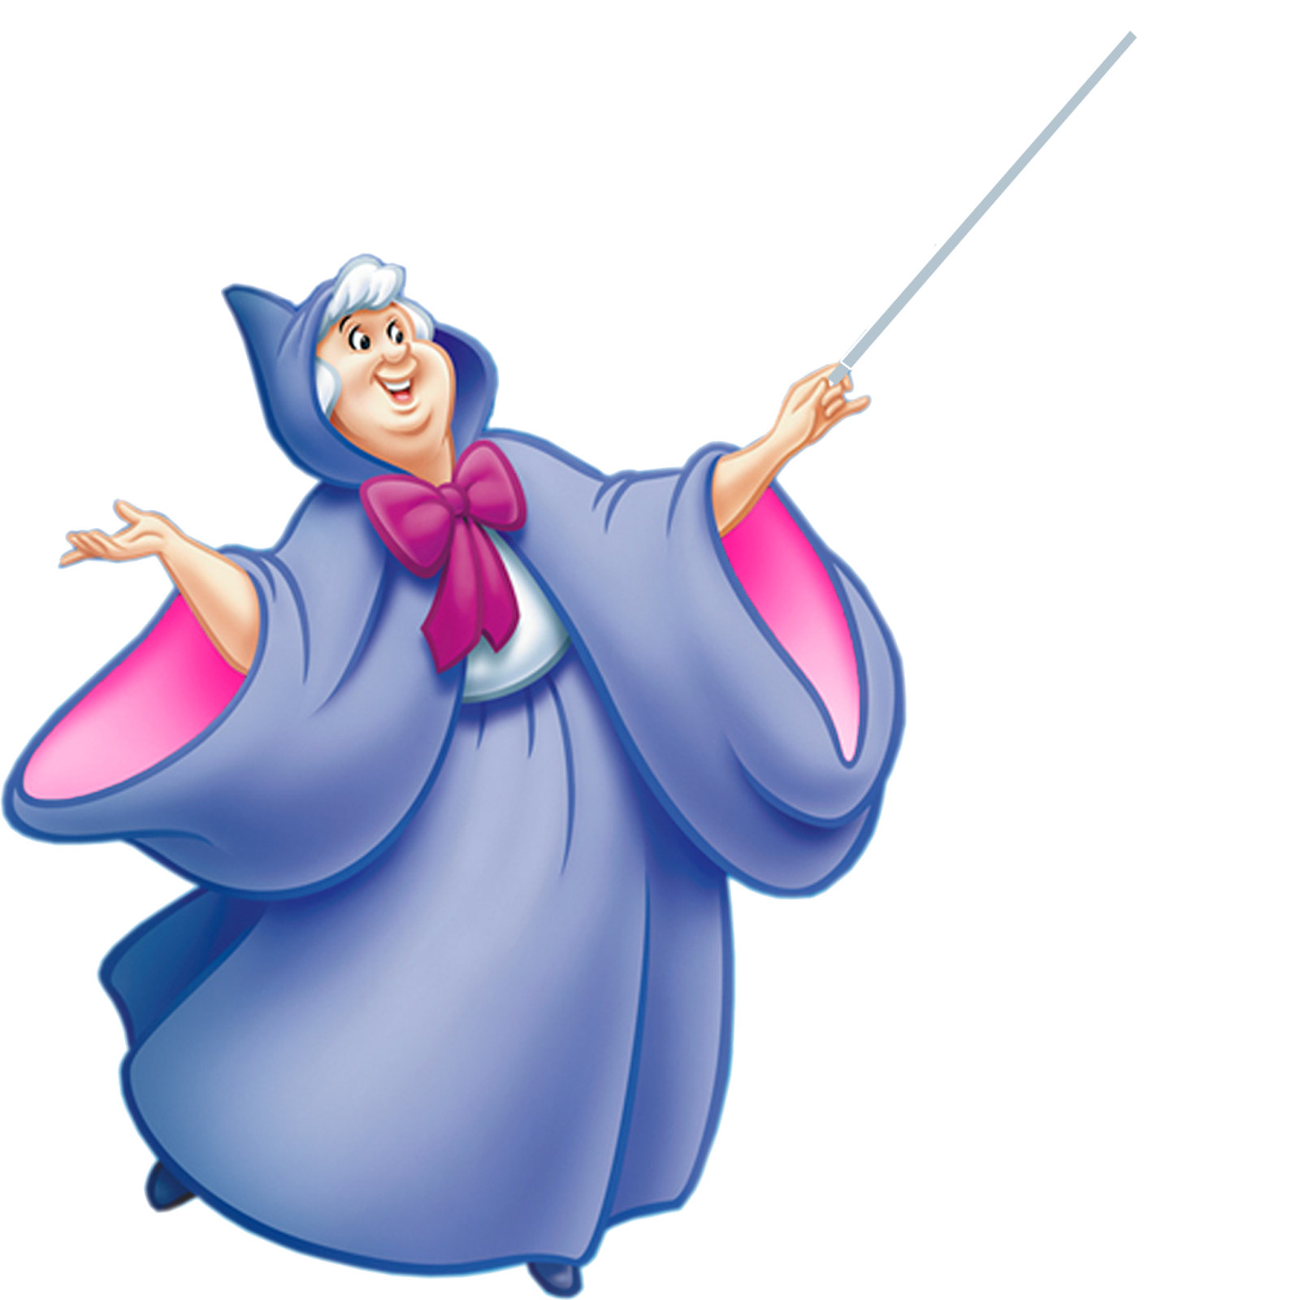


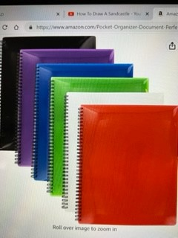
Classroom Wishlist
Raz-Kids
https://www.raz-kids.com
Online guided reading program with interactive ebooks, downloadable books, and reading quizzes.
Amazon Classroom Wishlist
$ 118.00 yearly.
Requesting
$ 5.00 per student
https://www.amazon.com/hz/wishlist/ls/1S0Q
ZUDPYO429?ref_=wl_share
Already purchased
Requesting
$ 5.00 per student
@Jamie-Kortum

Slide 26


Contact Information
Please feel free to send me a note or an email regarding any questions or concerns.
*** Remind
Cal Aero Preserve (909) 606-8531
Jamie_Kortum@chino.k12.ca.us
I’m looking forward to a terrific year!
Thank you ☺
Notes:
26

